Slide 1

Frequency Support Mechanisms in Electricity Grid and Wind Turbine Applications
Erencan Duymaz
Tuesday, October 13th, 2017

Slide 2
About Me
Education
BSc. Electrical and Electronics Engineering METU
Power Systems and Power Electronics 2010-2016
MSc. Electrical and Electronics Engineering METU
Power Electronics and Electric Machines 2016-2018 (Expected)
Work Experience
Researcher at PowerLab Research Group
Aug 2016 - Present

Slide 3
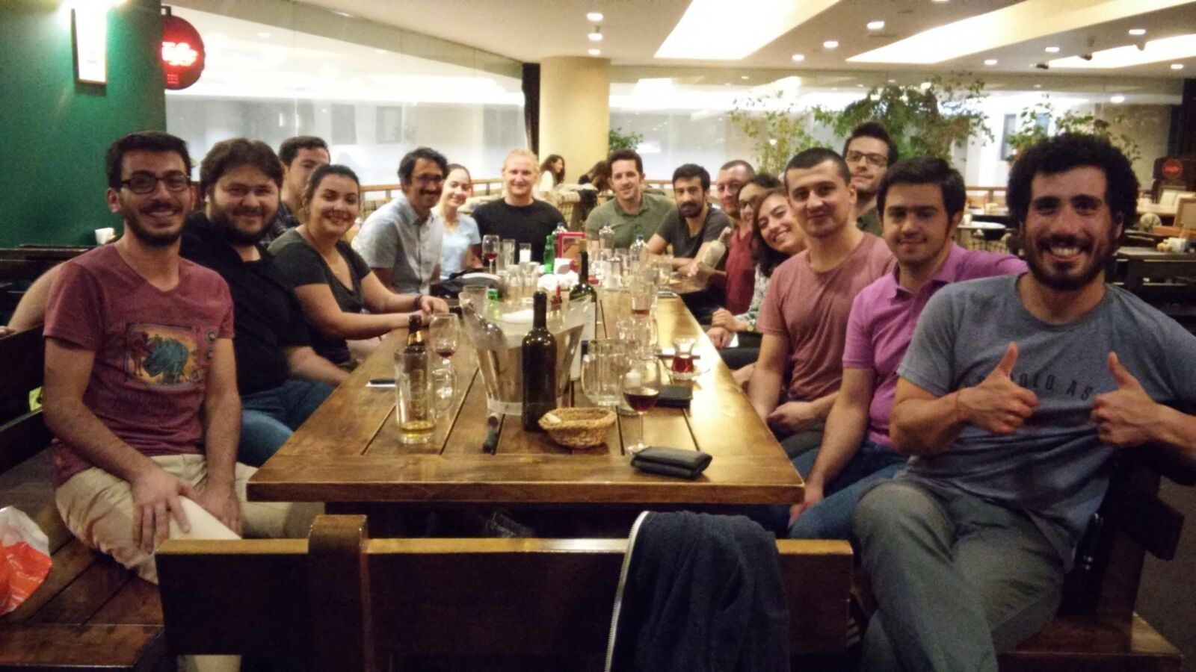
About PowerLab

Slide 4
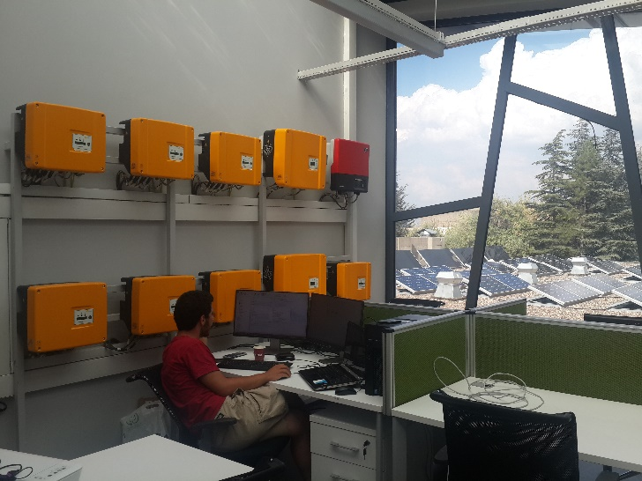
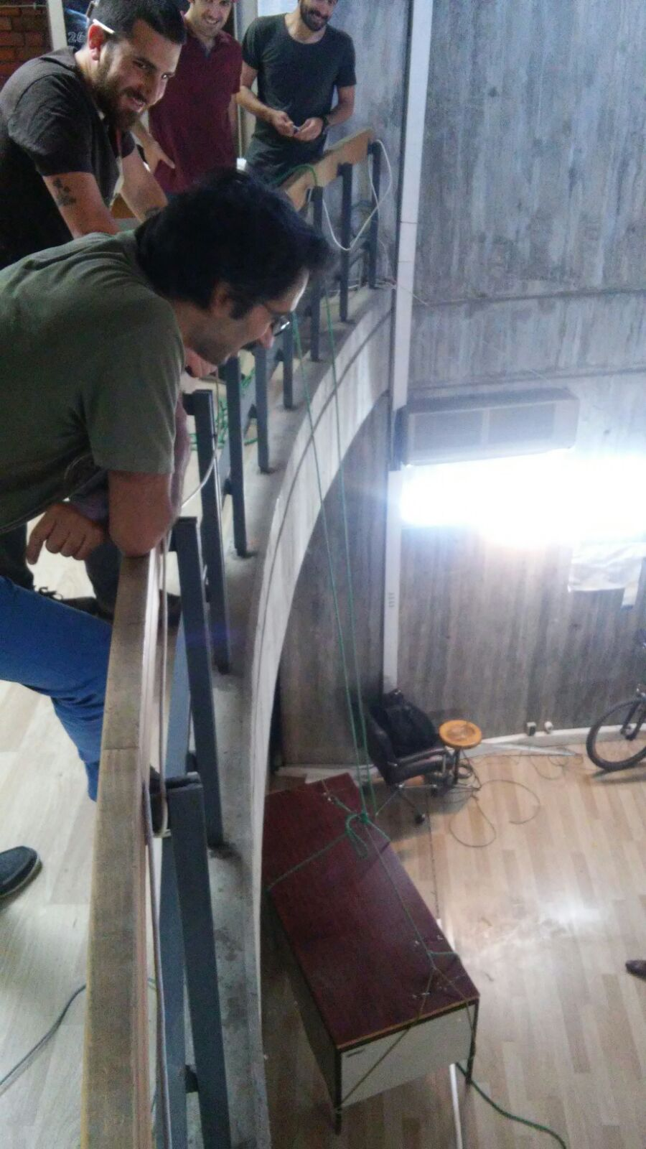
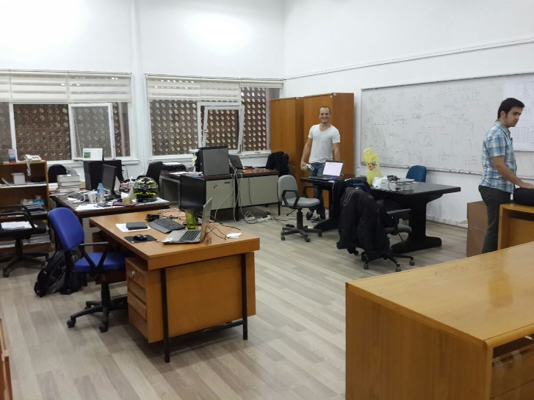
About PowerLab
ARC-300
C-114
E-101

Slide 5
Outline
Renewable Energy Today
Renewable Energy Challenges
Frequency and Inertia in Electricity Grid
Frequency Dynamics
Synthetic Inertia Implementation in Wind Turbines
Other Applications

Slide 6
Renewable Energy Today
The target to be reached by 2020 for the EU is a share of 20% energy from renewable sources in gross final consumption of energy.
To achieve this, EU countries have committed to reaching their own national renewables targets ranging from 10% in Malta to 49% in Sweden

Slide 7
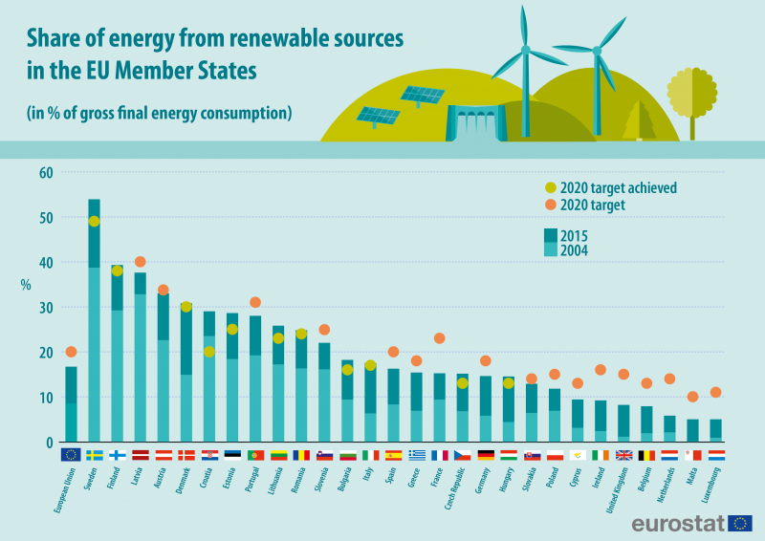
Renewable Energy Today
11 EU countries have already reached 2020 targets!!!

Slide 8
Renewable Energy Challenges
Uncertain Power Generation Profile
No Primary or Secondary controls
In the past;
Government buys whatever they generate
Free to disconnect
No ancillary services

Slide 9
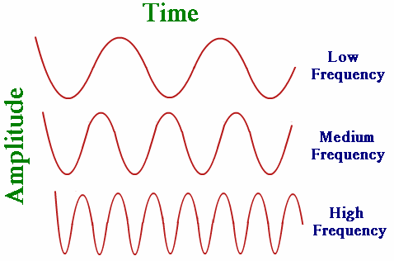
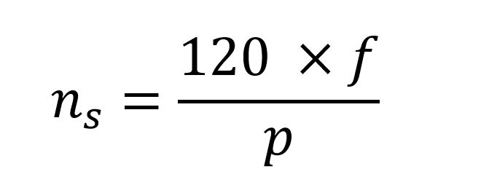
Frequency

Slide 10
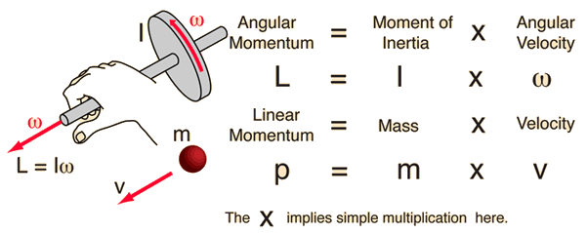
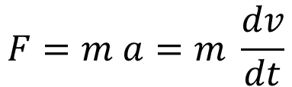
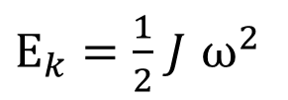
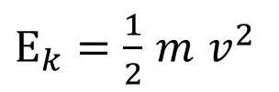
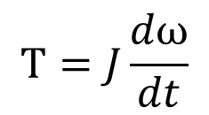
Inertia
$$F=m a=m \frac{dv}{dt}$$
$$T=J\frac{dω}{dt}$$
$E_{k}=\frac{1}{2}$ $m$ $v^{2}$
$E_{k}=\frac{1}{2}$ $J$ $ω^{2}$
Notes:
A successful engineer must be able to communicate his findings and ideas to others.
Engineers are in need of communication more than most other professionals.
Clear presentations and reports brings an engineer to the attention of the project leader and management.
The purpose : transmission & reception of information
It is most important not to disregard the receiver of information.
Information must be in a form that can be understood by the receiver.

Slide 11
Power Balance
Source: https://goo.gl/y6lwc1

Slide 12
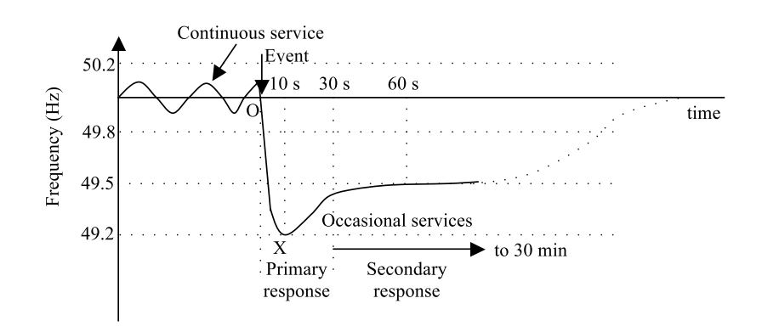
Frequency Regulating Mechanisms in Grid

Slide 13
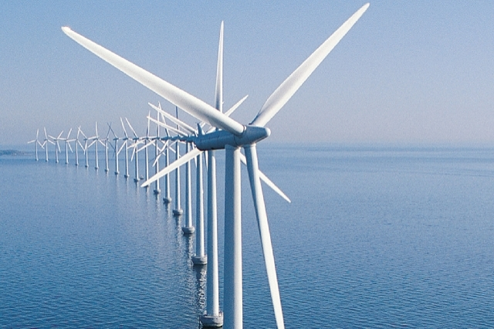

Renewable Sources

Slide 14
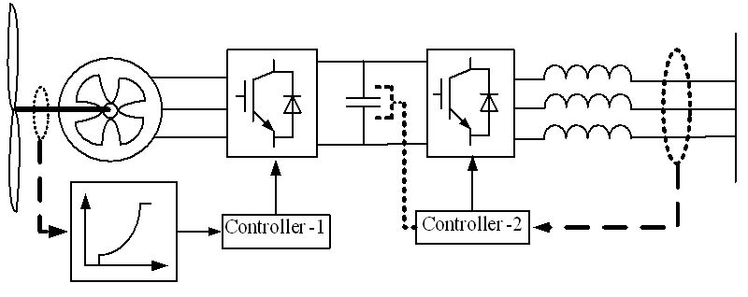
Renewable Sources

Slide 15
Solution : Synthetic Inertia
Frequency is monitored!
Decrease speed
Inject more power to arrest the frequency decrease!

Slide 16


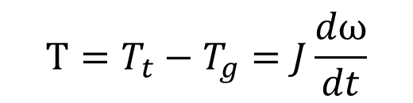
Solution : Synthetic Inertia
$$T_{t}=T_{g}$$
$$T=T_{t}−T_{g}=J\frac{dω}{dt}$$
$$P=T_{g}ω$$

Slide 17
Conclusion
Frequency and Inertia
Power Balance
Renewable Sources
Synthetic Inertia
Its implementation on WTE

Slide 18
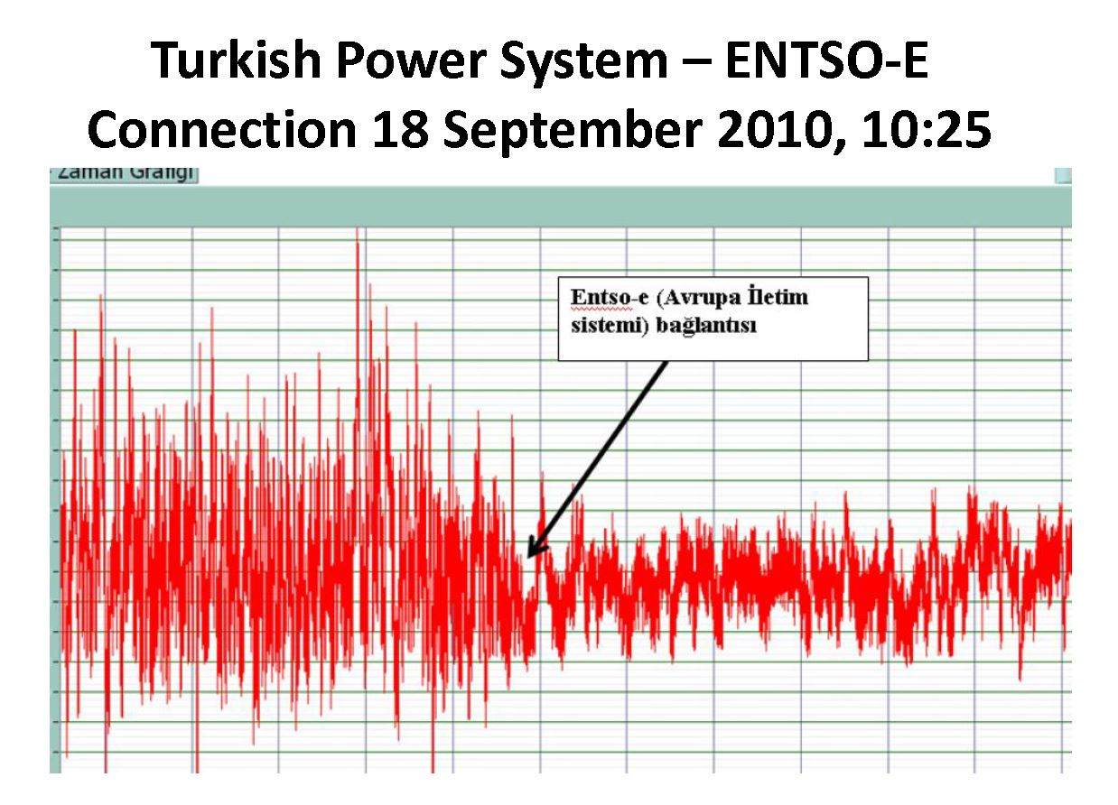
Connection of Turkish Power System to Europe
Reference [3]

Slide 19
References
J. Castelló, J. M. Espí, and R. García-Gil, “Development details and performance assessment of a Wind Turbine Emulator,” Renew. Energy, vol. 86, pp. 848–857, 2016.
A. Ulbig, T. S. Borsche, and G. Andersson, “Analyzing Rotational Inertia, Grid Topology and their Role for Power System Stability,” IFAC-PapersOnLine, vol. 48, no. 30, pp. 541–547, 2015.
N. Güven, “INTRODUCTION TO POWER SYSTEMS ” EE 472 POWER SYSTEM ANALYSIS II

Slide 20

Thank you!

